Slide 1
Software Product Management Marketing
Nandagopal Govindan

Slide 2
Marketing concepts for
Product managers

Slide 3
Contents
Concepts in marketing
4Ps of marketing
Pricing strategies
Positioning & messaging (Al Reis)
Product marketing
Content marketing
Go to market strategy

Slide 4
Definition
What is marketing?
American Marketing association “….. creating, communicating, delivering offerings that have value for customers, clients, …”
Peter Drucker “… Aim of marketing is to make sales superfluous. …. Understand the customer so well that the product sells itself….”

Slide 5
Concepts in Marketing
(Marketing Management book by Philip Kotler)
Customer needs
Stated (inexpensive car),
Unstated (Good service),
Delights (Onboard GPS)
Target market & Segmentation: Some examples
By Industry to which customer belongs
By Customer size and sales potential
By Geography

Slide 6
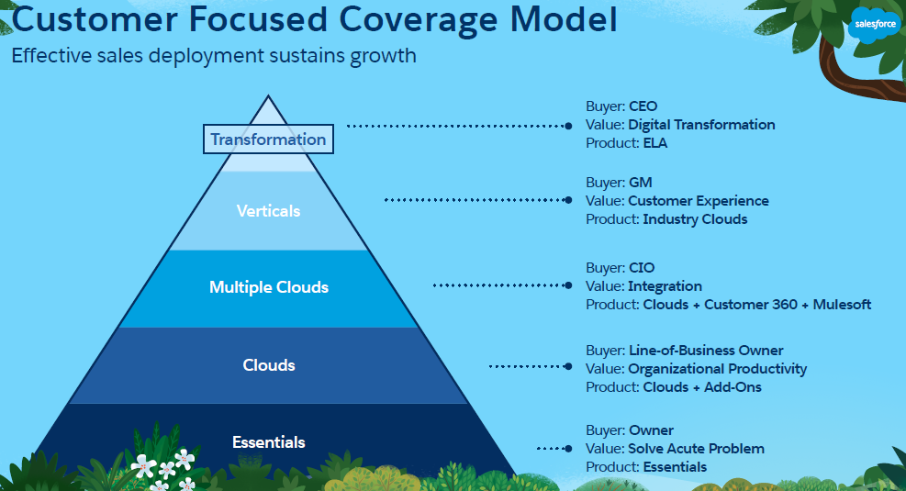
How does Salesforce address different customers segments?

Slide 7
Concepts in Marketing
(Marketing Management book by Philip Kotler)
Positioning:
Creates a position in the prospects mind based on the value of the product to the market segment and how different it is from the competition
Examples
Volvo - Safest car
Porsche - Pleasurable and exciting driving experience
Toyota – High quality
Accenture: Innovative solutions (“Innovation delivered”)
TCS: Value for money
Apple: Innovative, Creative
SalesForce: User friendly – Easy to setup, easy to use, customizable
AirBnB: Local experience
BYJU’s: High quality coaching

Slide 8
Ways to position
Be the first:
People remember Neil Armstrong was the first to land on moon. Not many remember his colleague who landed next
People remember BigBasket for grocery and vegetables because it entered the market first (First mover advantage)
Find a niche:
Apna is a job finder for blue collar workers
Tally is for Small and Medium Enterprises
Differentiate from competition
Sketch is very easy to use compared to Photoshop
Progressive Auto Insurance is quick claim settlement

Slide 9
Exercise
How can you help position these products?
Postman
Kissflow

Slide 10
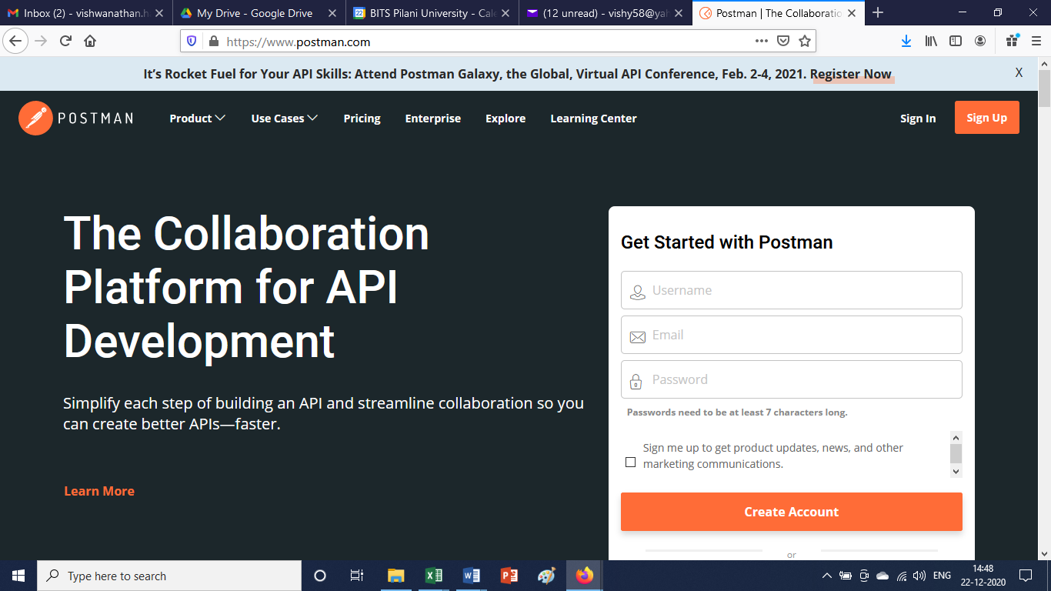
Messaging
Positioning & Messaging are closely linked
Messaging is how you communicate value proposition using simple & clear words
Messaging of Postman:

Slide 11
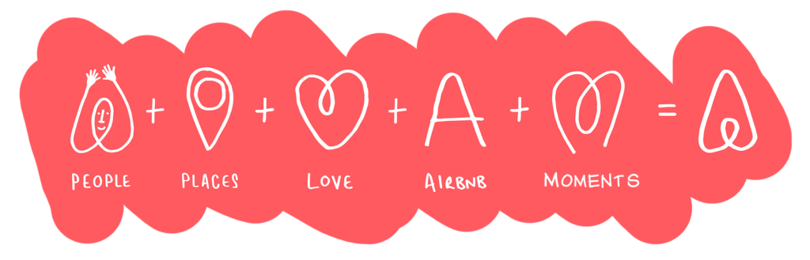
Messaging: AirBnB

Slide 12
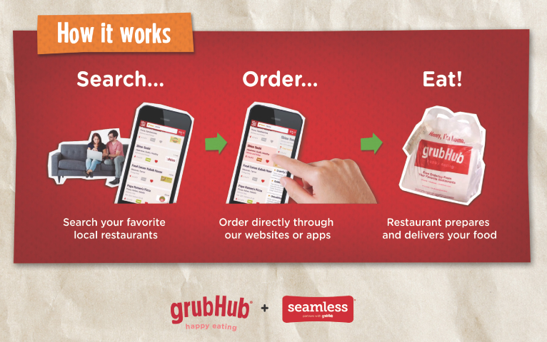
Messaging: Example

Slide 13
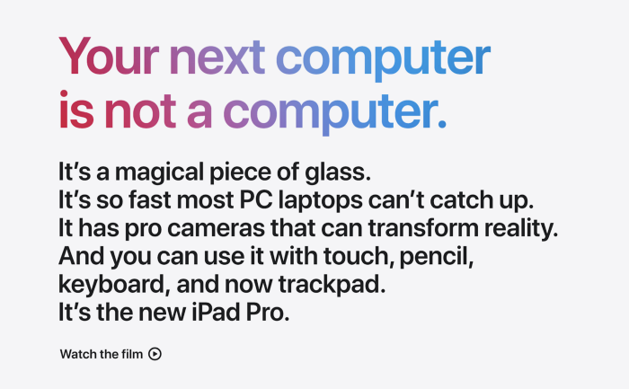
Messaging example: iPad

Slide 14
Concepts in Marketing
Branding
Branding helps to identify a product and distinguish it from other products and services.
Branding consists of Logo, name, mission, values
Apple creates an image of creative, innovation, easy to use
Marketing channels
Communication channels: newspaper, magazine, mail, internet, blogs
Distribution channels: Direct (Internet) and indirect (distributors, retailers, associates)
Paid, owned and earned media
Paid: Newspaper, paid search (Google AdWords)
Owned: Web site, blog, Facebook page, Twitter account, LinkedIn
Earned: When press, consumers talk about the brand (word of mouth, viral marketing), Trust Radius, Capterra, Product Hunt

Slide 15
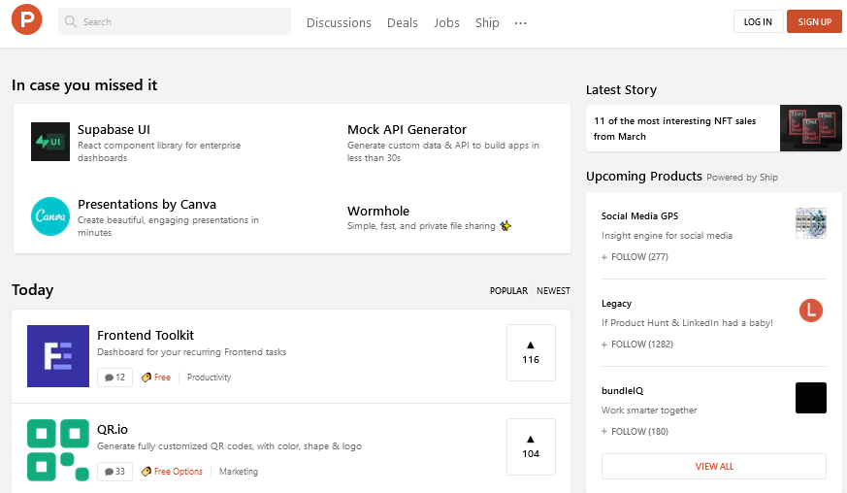
Product Hunt: Best new products in tech website

Slide 16
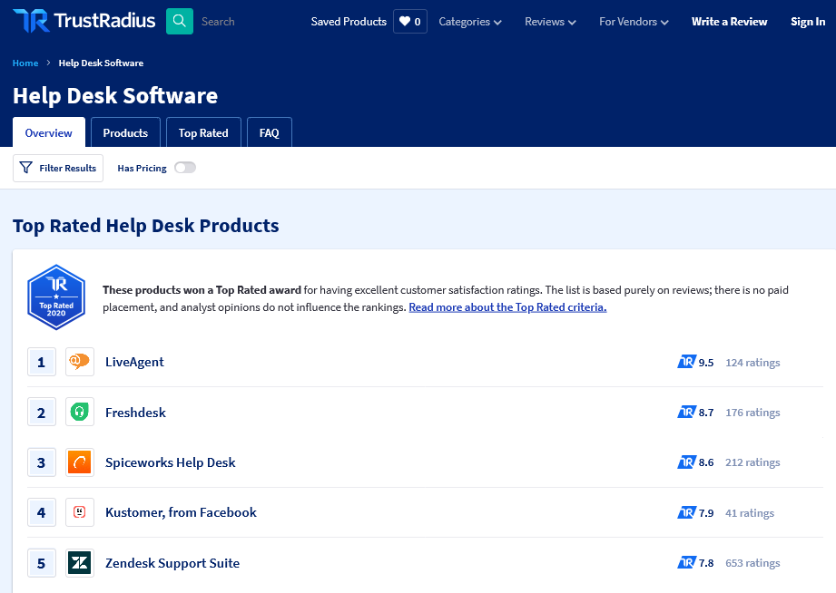
Trust Radius: Software reviews & comparisons website

Slide 17
Concepts in Marketing
Impression & engagement
Impression: How many viewed the advertisement
Engagement: How many “Like”, how many tweeted about it, how many commented on blog, how many shared your content such as video, with their friends & colleagues
Value & satisfaction
Depends on quality, service and price

Slide 18
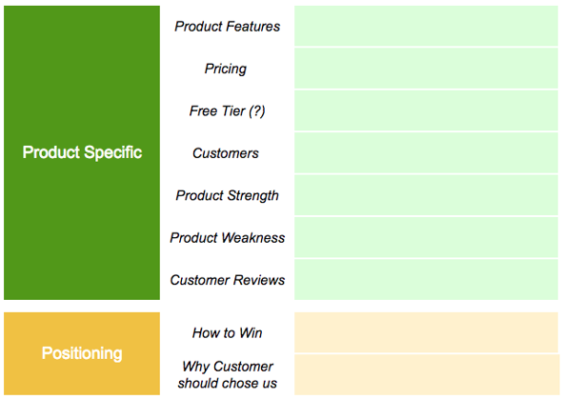
Competitor analysis

Slide 19
Concepts in Marketing
Consumer adoption process (Funnel)
Awareness
Interest
Evaluation
Trial
Adoption

Slide 20
Concepts in Marketing
Marketing communication mix
Advertisement (Newspaper, Magazine, Internet)
Sales promotion (short term incentive)
Events & experiences (webinars)
Public relations & publicity (CSR activity)
Online and social media marketing (web sites, blogs, Facebook & Twitter channels, Influencers, search ads, engage customers)
Mobile marketing
Direct & database marketing (email, Mailchimp)
Personal selling (face to face presentations)

Slide 21
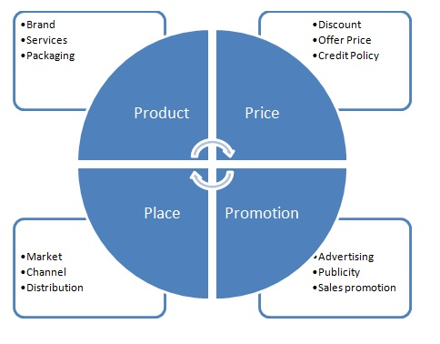
4Ps of marketing

Slide 22
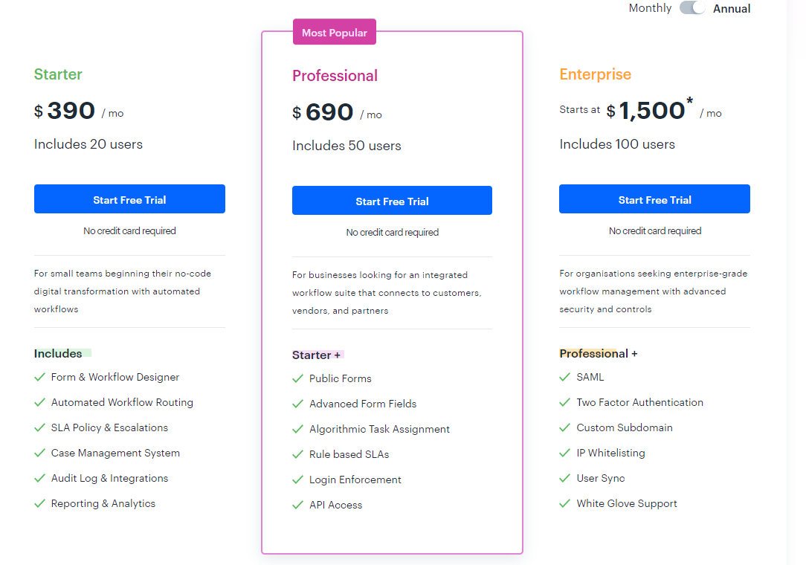
Pricing example: Kissflow

Slide 23
Pricing considerations
Some considerations
Affordability
Expectations
Competition
Value generated
Market size
Example Bounce:
We can consider how much user is currently spending to reach Metro station. Can we price it below this?

Slide 24
Exercise
What factors will you consider to price these products? Justify
Slack:
Value due to easier collaboration and productivity increase
Spotify:
Affordability & Expectations
Postman:
Price of Testing tools, other development tools
KissFlow:
Increase in productivity

Slide 25
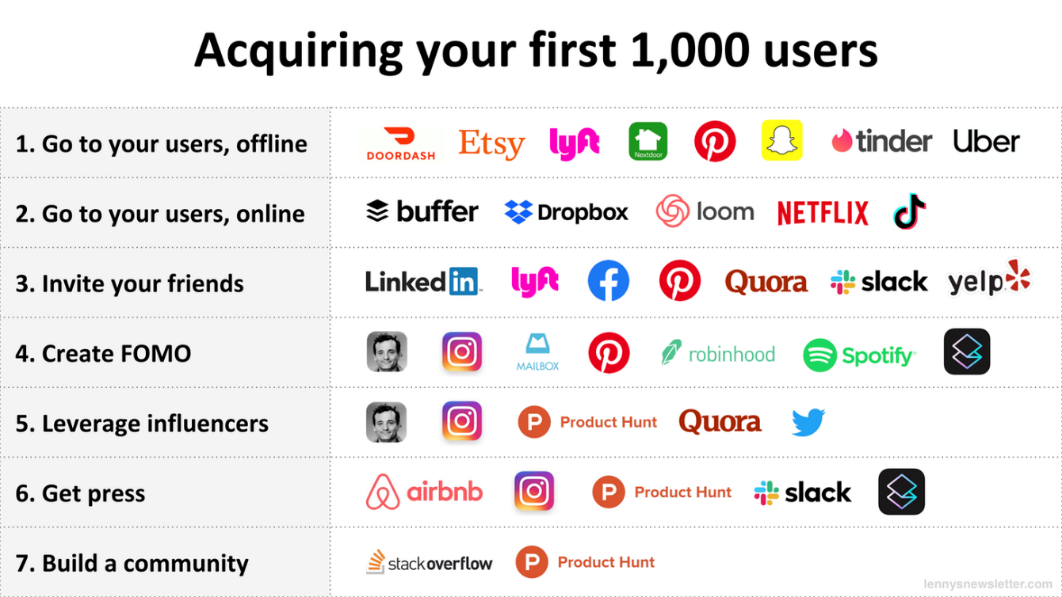
B2C: How they got their first 1,000 users (lennysnewsletter.com)

Slide 26
B2C: How they got their first 1000 users – B2C
Offline: Visit College campus, Malls, Exhibitions, Transit hubs, Startup office
Online: Publish on HackerNews (DropBox), App store (TikTok), Product Hunt (Loom),
Invite your friends: Slack did it
Create FOMO: (Fear of missing out): use tactics like by Invite only, Waiting list,
Leverage influencers: Invite a person who is respected by the customer community to join / subscribe
Get press: Write an article in magazines
Build community: Invite supporters to join

Slide 27
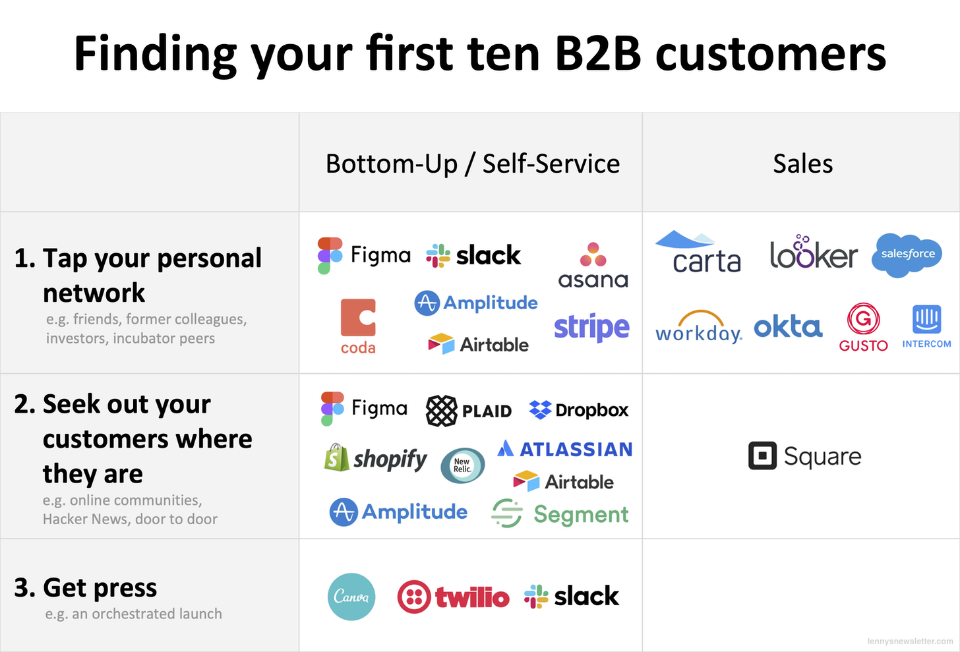
B2B: How they found their first ten customers?
(lennysnewsletter.com)

Slide 28
Content marketing
Content marketing is strategic marketing and business process focused on creating and distributing valuable, relevant, and consistent content to attract and retain a clearly defined audience, and, ultimately, drive profitable customer action. (HubSpot)
Important for Search Engine Optimisation
Building and engaging a lasting relationship with your audience
Increase brand credibility and loyalty

Slide 29
Examples of content marketing
Workday
Focuses on financial management SAAS and enterprise HR, and is a leader in the Gartner Magic Quadrant.
In relation to their content marketing, their video marketing stands out
After watching a video, 64% of users are more likely to buy a product online.
Zendesk
Is a customer service platform, providing great support with self-service and proactive engagement.
Their content focused on educating their audience about the best ways to bring business and customers closer together

Slide 30
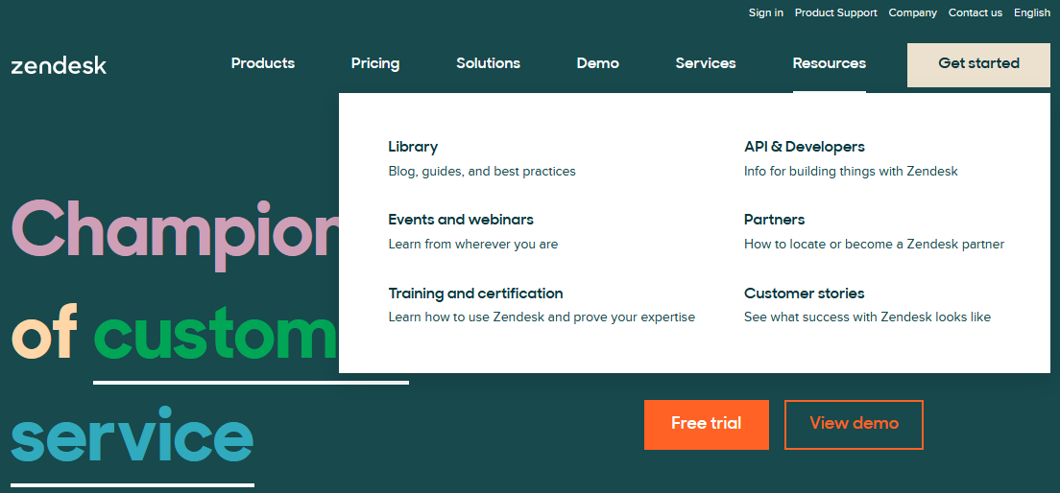
Content: Zendesk

Slide 31
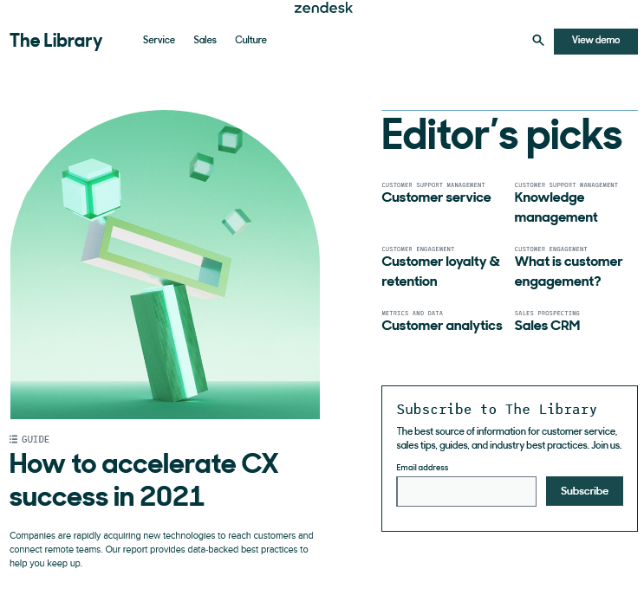

Slide 32
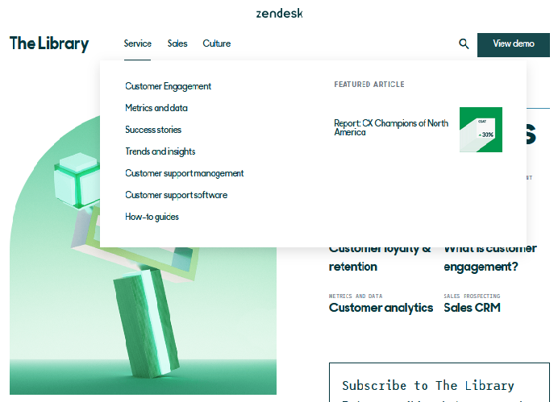
Zendesk: Content

Slide 33
Product marketing
Product marketing should have a deep understanding of the customer and the market.
Before a product launch, product marketers typically own positioning, messaging, gathering customer feedback, and the overall go-to-market strategy for a product.
After a product launch, product marketers help with sales enablement and focus on driving demand, adoption, and the overall success of the product.
Ref: drift.com

Slide 34
Go-to-market strategy
Go-to-market strategy is how a company plans to reach its customers
It consists of:
Defining a target market
Pricing strategy
Choosing the distribution & marketing channel
Decide on support
Decide on promotion
Decide on market campaign

Slide 35
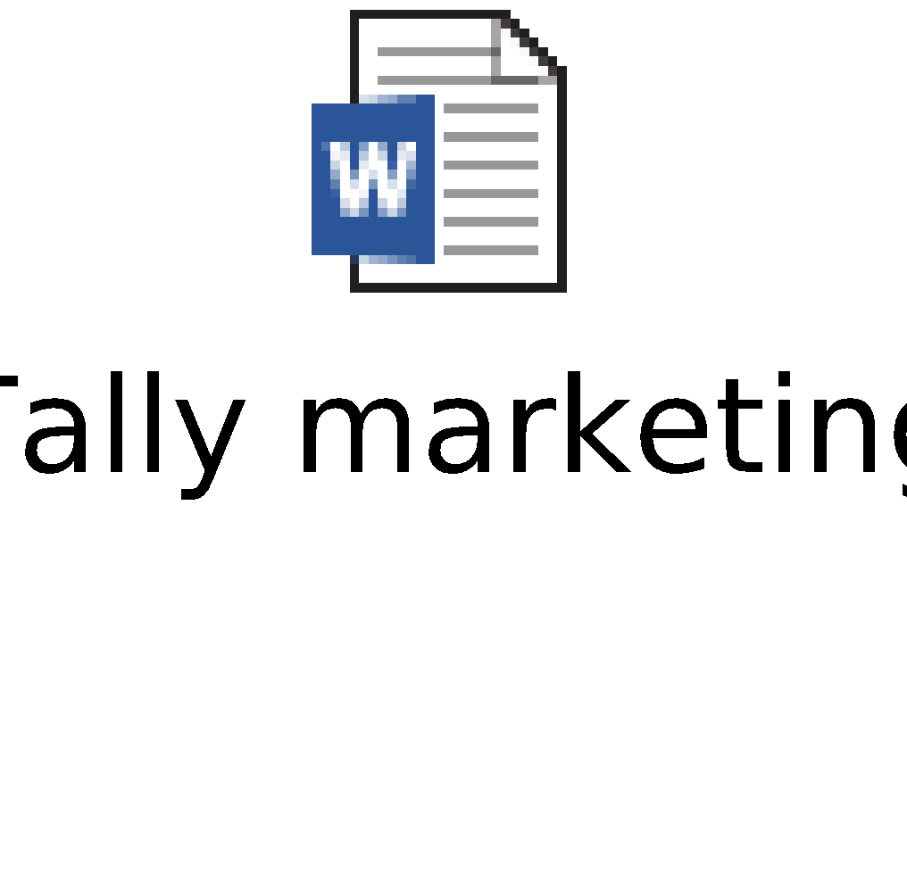
Case study: Tally
Questions:
What key lessons can we learn about marketing from this case study?
What else could have been done to further strengthen the marketing?

Slide 36
Experience sharing

Slide 37
Appendix

Slide 38
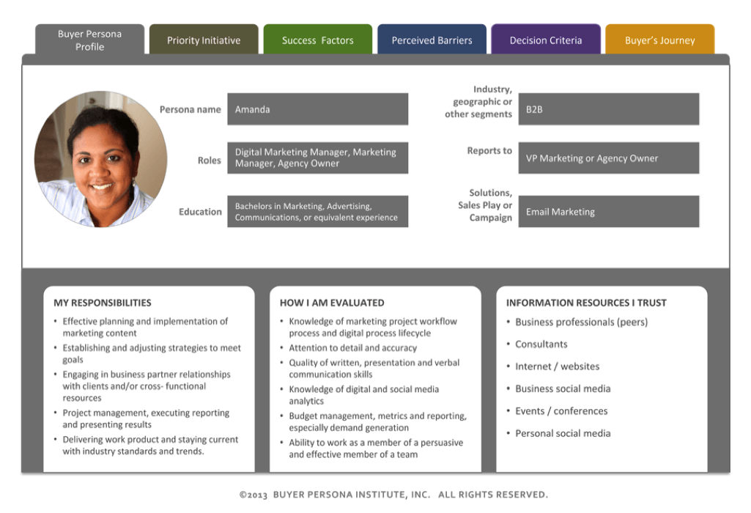
Buyer Persona

Slide 39
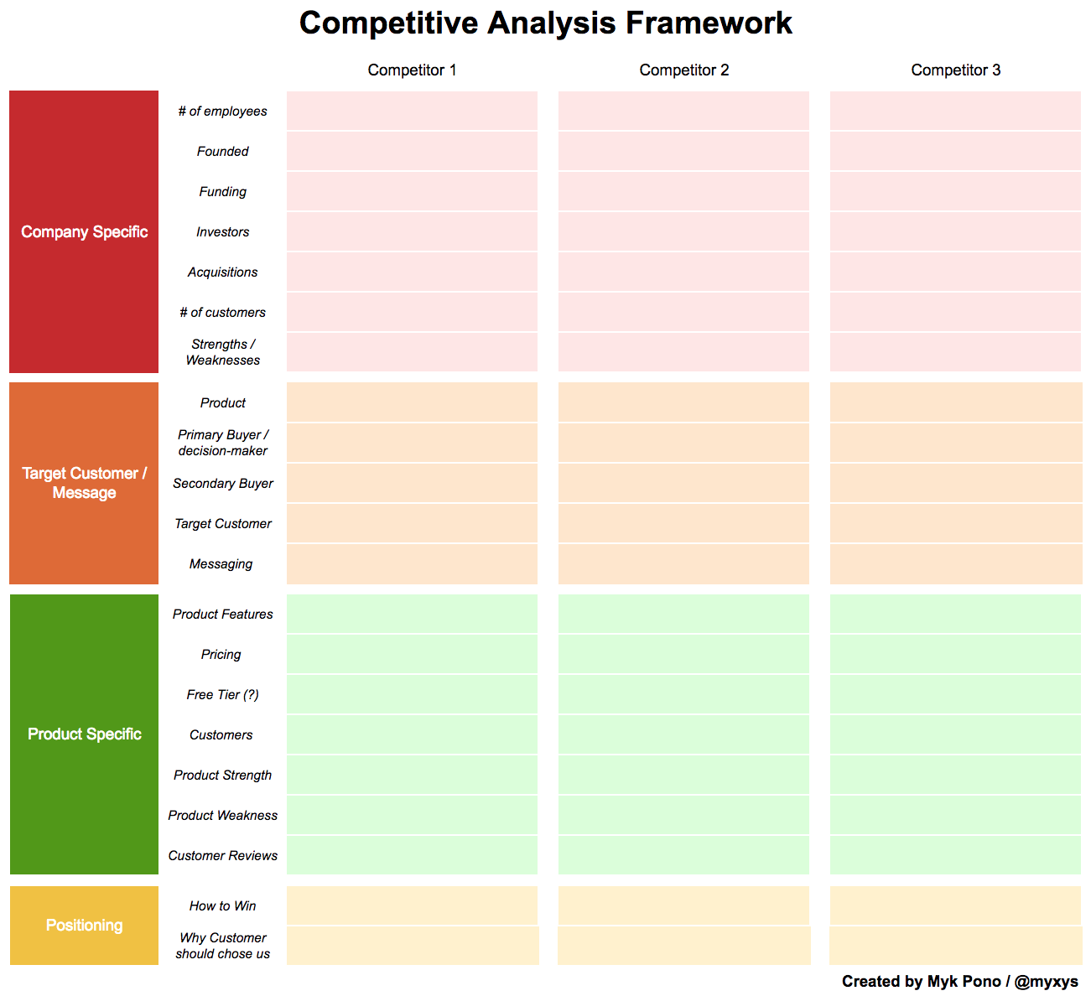
Competitor analysis

Slide 40
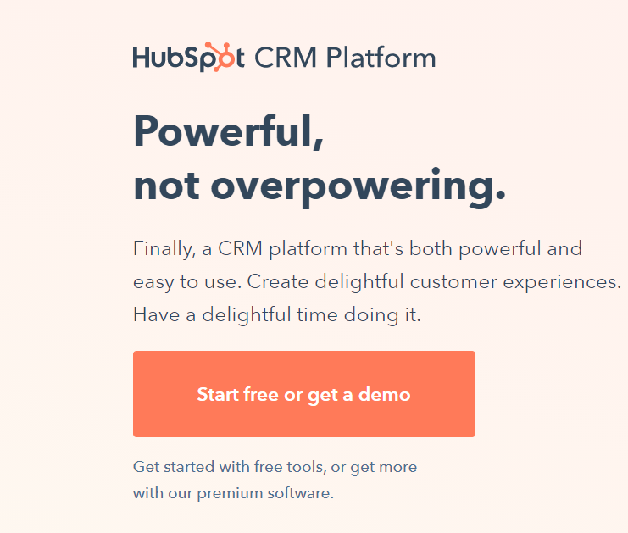
Messaging and Positioning

Slide 41
Go to market process
-Updates to the public website; stages announcement emails and in-platform messages; and stages internal company notifications
-MARKETING operationalizes design assets
-MARKETING creates customer-facing emails and in-product messaging
-MARKETING stages prospect-facing communication and SALES enablement document
-MARKETING considers one-off prospect email opportunities
-MARKETING considers PR opportunities — announcement or press release
-MARKETING considers organic & paid amplification opportunities

Slide 42
Pricing: Kissflow

